Slide 1
Unit 3 Lab Review

Slide 2
A good or service that satisfies the needs of consumers over a short period.
Economic cost
Consumption good
Concave function
Conspicuous consumption
The out-of-pocket cost of an action, plus the opportunity cost.
A good or service that satisfies the needs of consumers over a short period.
A function of two variables for which the line segment between any two points on the function lies entirely below the curve representing the function (the function is convex when the line segment lies above the function).
The purchase of goods or services to publicly display one’s social and economic status.

Slide 3
The trade-off that a person is willing to make between two goods. At any point, this is the slope of the indifference curve.
The trade-off that a person is willing to make between two goods. At any point, this is the slope of the indifference curve.
The additional amount of output that is produced if a particular input was increased by one unit, while holding all other inputs constant.
This problem is about how we can do the best for ourselves, given our preferences and constraints, and when the things we value are scarce.
The quantity of some good that must be sacrificed to acquire one additional unit of another good. At any point, it is the slope of the feasible frontier.
Marginal rate of substitution
Marginal product
Constrained choice problem
Marginal rate of transformation

Slide 4
A curve of the points which indicate the combinations of goods that provide a given level of utility to the individual.
An equation that represents all combinations of goods and services that one could acquire that exactly exhaust one’s budgetary resources.
A graphical or mathematical expression describing the amount of output that can be produced by any given amount or combination of input(s). The function describes differing technologies capable of producing the same thing.
A curve of the points which indicate the combina­tions of goods that provide a given level of utility to the individual.
The effect that the additional income would have if there were no change in the price or opportunity cost.
Budget constraint
Production function
Indifference curve
Income effect

Slide 5
The curve made of points that defines the maximum feasible quantity of one good for a given quantity of the other.
A curve of the points which indicate the combina­tions of goods that provide a given level of utility to the individual.
The curve made of points that defines the maximum feasible quantity of one good for a given quantity of the other.
The additional amount of output that is produced if a particular input was increased by one unit, while holding all other inputs constant.
The effect that is only due to changes in the price or opportunity cost, given the new level of utility.
Indifference curve
Feasible frontier
Marginal product
Substitution effect

Slide 6
A payment or other benefit received above and beyond what the individual would have received in his or her next best alternative (or reservation option).
All of the combinations of the things under consideration that a decision-maker could choose given the economic, physical or other constraints that he faces.
The out-of-pocket cost of an action, plus the opportunity cost.
A payment or other benefit received above and beyond what the individual would have received in his or her next best alternative (or reservation option).
A function of two variables for which the line segment between any two points on the function lies entirely below the curve representing the function (the function is convex when the line segment lies above the function).
Feasible set
Economic cost
Economic rent
Concave function

Slide 7
The additional amount of output that is produced if a particular input was increased by one unit, while holding all other inputs constant.
Opportunity cost
Feasible frontier
Marginal product
Marginal rate of transformation
When taking an action implies forgoing the next best alternative action, this is the net benefit of the foregone alternative.
The curve made of points that defines the maximum feasible quantity of one good for a given quantity of the other.
The additional amount of output that is produced if a particular input was increased by one unit, while holding all other inputs constant.
The quantity of some good that must be sacrificed to acquire one additional unit of another good. At any point, it is the slope of the feasible frontier.

Slide 8
A description of the benefit or cost we associate with each possible outcome.
Economic cost
Income effect
Preferences
Indifference curve
The out-of-pocket cost of an action, plus the opportunity cost.
The effect that the additional income would have if there were no change in the price or opportunity cost.
A description of the benefit or cost we associate with each possible outcome.
A curve of the points which indicate the combina­tions of goods that provide a given level of utility to the individual.

Slide 9
A good that is valued, and for which there is an opportunity cost of acquiring more.
Scarcity
Consumption good
Economic rent
Marginal rate of transformation
A good that is valued, and for which there is an opportunity cost of acquiring more.
A good or service that satisfies the needs of consumers over a short period.
A payment or other benefit received above and beyond what the individual would have received in his or her next best alternative (or reservation option).
The quantity of some good that must be sacrificed to acquire one additional unit of another good. At any point, it is the slope of the feasible frontier.

Slide 10
A description of the benefit or cost we associate with each possible outcome.
Income effect
Economic cost
Preferences
Indifference curve
The effect that the additional income would have if there were no change in the price or opportunity cost.
The out-of-pocket cost of an action, plus the opportunity cost.
A description of the benefit or cost we associate with each possible outcome.
A curve of the points which indicate the combina­tions of goods that provide a given level of utility to the individual.

Slide 11
The quantity of some good that must be sacrificed to acquire one additional unit of another good. At any point, it is the slope of the feasible frontier.
Constrained choice problem
Diminishing marginal product
Marginal rate of transformation
Marginal product
This problem is about how we can do the best for ourselves, given our preferences and constraints, and when the things we value are scarce.
A property of some production functions according to which each additional unit of input results in a smaller increment in total output than did the previous unit.
The quantity of some good that must be sacrificed to acquire one additional unit of another good. At any point, it is the slope of the feasible frontier.
The additional amount of output that is produced if a particular input was increased by one unit, while holding all other inputs constant.

Slide 12
A graphical or mathematical expression describing the amount of output that can be produced by any given amount or combination of input(s). The function describes differing technologies capable of producing the same thing.
Production function
Diminishing returns
Marginal product
Indifference curve
A graphical or mathematical expression describing the amount of output that can be produced by any given amount or combination of input(s). The function describes differing technologies capable of producing the same thing.
A situation in which the use of an additional unit of a factor of production results in a smaller increase in output than the previous increase.
The additional amount of output that is produced if a particular input was increased by one unit, while holding all other inputs constant.
A curve of the points which indicate the combina­tions of goods that provide a given level of utility to the individual.

Slide 13
When two curves share one point in common but do not cross. The tangent to a curve at a given point is a straight line that touches the curve at that point but does not cross it.
When two curves share one point in common but do not cross. The tangent to a curve at a given point is a straight line that touches the curve at that point but does not cross it.
A numerical indicator of the value that one places on an outcome, such that higher valued outcomes will be chosen over lower valued ones when both are feasible.
All of the combinations of the things under consideration that a decision-maker could choose given the economic, physical or other constraints that he faces.
When consumption expenditures is less than net income, saving takes place and wealth rises.
Tangency
Utility
Feasible set
savings

Slide 14
A numerical indicator of the value that one places on an outcome, such that higher valued outcomes will be chosen over lower valued ones when both are feasible.
A good that is valued, and for which there is an opportunity cost of acquiring more.
A payment or other benefit received above and beyond what the individual would have received in his or her next best alternative (or reservation option).
A numerical indicator of the value that one places on an outcome, such that higher valued outcomes will be chosen over lower valued ones when both are feasible.
When two curves share one point in common but do not cross. The tangent to a curve at a given point is a straight line that touches the curve at that point but does not cross it.
Scarcity
Economic rent
Utility
Tangency

Slide 15
All of the combinations of the things under consideration that a decision-maker could choose given the economic, physical or other constraints that he faces.
All of the combinations of the things under consideration that a decision-maker could choose given the economic, physical or other constraints that he faces.
A payment or other benefit received above and beyond what the individual would have received in his or her next best alternative (or reservation option).
The effect that the additional income would have if there were no change in the price or opportunity cost.
The curve made of points that defines the maximum feasible quantity of one good for a given quantity of the other.
Feasible set
Economic rent
Income effect
Feasible frontier

Slide 16
This problem is about how we can do the best for ourselves, given our preferences and constraints, and when the things we value are scarce.
Conspicuous consumption
Constrained choice problem
Diminishing returns
Diminishing marginal product
The purchase of goods or services to publicly display one’s social and economic status.
This problem is about how we can do the best for ourselves, given our preferences and constraints, and when the things we value are scarce.
A situation in which the use of an additional unit of a factor of production results in a smaller increase in output than the previous increase.
A property of some production functions according to which each additional unit of input results in a smaller increment in total output than did the previous unit.

Slide 17
A situation in which the use of an additional unit of a factor of production results in a smaller increase in output than the previous increase.
Diminishing marginal product
Opportunity cost
Diminishing returns
Production function
A property of some production functions according to which each additional unit of input results in a smaller increment in total output than did the previous unit.
When taking an action implies forgoing the next best alternative action, this is the net benefit of the foregone alternative.
A situation in which the use of an additional unit of a factor of production results in a smaller increase in output than the previous increase.
A graphical or mathematical expression describing the amount of output that can be produced by any given amount or combination of input(s). The function describes differing technologies capable of producing the same thing.

Slide 18
The effect that the additional income would have if there were no change in the price or opportunity cost.
The effect that is only due to changes in the price or opportunity cost, given the new level of utility.
A curve of the points which indicate the combina­tions of goods that provide a given level of utility to the individual.
The curve made of points that defines the maximum feasible quantity of one good for a given quantity of the other.
The effect that the additional income would have if there were no change in the price or opportunity cost.
Substitution effect
Indifference curve
Feasible frontier
Income effect

Slide 19
Study Hours | 0 | 1 | 2 | 3 | 4 | 5 | 6 | 7 | 8 | 9 | 10 | 11 | 12 | 13 | 14 | 15 or more
Grade | 0 | 20 | 33 | 42 | 50 | 57 | 63 | 69 | 73 | 78 | 81 | 84 | 86 | 88 | 89 | 90
True or False
The marginal product and the average product are both constant beyond 15 hours.
False.
The marginal product is constant beyond 15 hours, but the average product continues to diminish. This is because the marginal product (zero) is less than the average product, which remains positive but is decreasing (more hours with no additional improvement reduces the average).

Slide 20
Study Hours | 0 | 1 | 2 | 3 | 4 | 5 | 6 | 7 | 8 | 9 | 10 | 11 | 12 | 13 | 14 | 15 or more
Grade | 0 | 20 | 33 | 42 | 50 | 57 | 63 | 69 | 73 | 78 | 81 | 84 | 86 | 88 | 89 | 90
True or False
The horizontal production function beyond 15 hours means that studying for more than 15 hours is detrimental to Alexei’s performance.
False.
If studying for more than 15 hours had a negative effect on Alexei’s grade, then the marginal product would be negative, implying a downward-sloping curve beyond 15 hours.

Slide 21
Study Hours | 0 | 1 | 2 | 3 | 4 | 5 | 6 | 7 | 8 | 9 | 10 | 11 | 12 | 13 | 14 | 15 or more
Grade | 0 | 20 | 33 | 42 | 50 | 57 | 63 | 69 | 73 | 78 | 81 | 84 | 86 | 88 | 89 | 90
True or False
The marginal product and the average product are approximately the same for the initial hour
True.
Because there are no previous hours to consider, the average product for the initial hour is just the improvement produced by a single hour, which in turn approximates to the marginal product from 0 to 1 hours (the precise marginal product changes over this interval, reflected in the decreasing slope of the production function).

Slide 22
Which of the following statements are true
 | A | E | F | G | H | D
Hours of free time | 15 | 16 | 17 | 18 | 19 | 20
Final Grade | 84 | 75 | 67 | 60 | 54 | 50
A is false because B is preferred as it is ona higher indifference curve
100
Alexei prefers C to B because at C he has more free time.
Alexei is indifferent between the grade of 84 with 15 hours of free time, and the grade of 50 with 20 hours of free time.
Alexei prefers D to C, because at D he has the same grade and more free time.
At G, Alexei is willing to give up 2 hours of free time for 10 extra grade points.
B is correct. A, where Alexei has the grade of 84 and 15 hours of free time, and D, where Alexei has the grade of 50 with 20 hours of free time, are on the same indifference curve.
B
A
84
E
75
F
G
H
D
50
Final grade
C-False. At D Alexei has the same amount of free time but a higher grade.
C
D- False. The opposite trade-off is true: going from G to D, Alexei is willing to give up 10 grade points for 2 extra hours of free time. Going from G to E, he is willing to give up 2 hours of free time for 15 extra grade points.
0
0
15
16
20
24
Hours of free time per day

Slide 23
The figure shows Alexei’s feasible frontier and his indifference curves for final grade and hours of free time per day. Which point represents the optimal combination of free time and grade for Alexi? Why?
100
Feasible
frontier
90
B
MRS = MRT
D
57
E
Final grade
C
IC₄
IC₃
IC₂
A
IC₁
0
0
19
24
Hours of free time per day

Slide 24
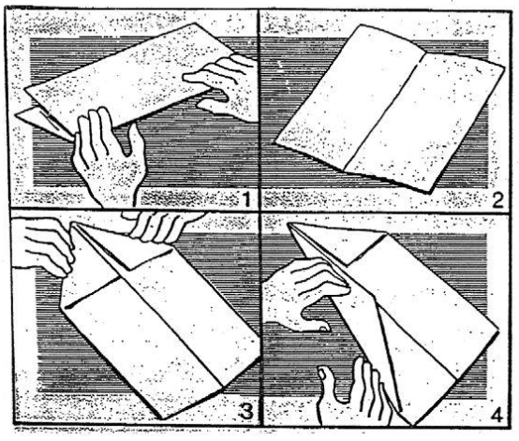
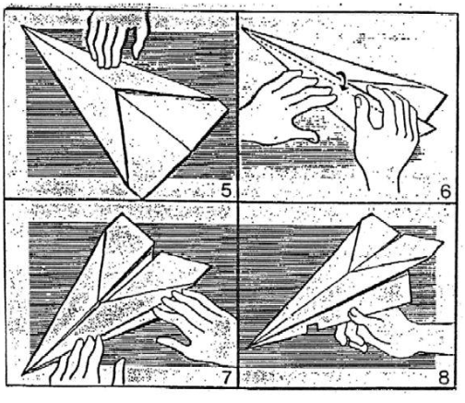
Paper Aeroplanes

