Slide 1
Stock Flow Consistent Models & Money
Economics of Public Sector
University of Redlands
B. Oak McCoy

Slide 2
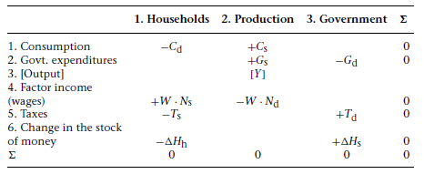
Simplest Model With Government Money
Transaction matrix shows the flow of finance across sectors of the economy resulting from real decisions.
Row 6 follows from the logical consistency of the model, the difference between income and outlays equals the change in that sectors stocks.

Slide 3
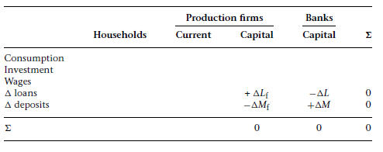
Production with bank money. Step 1.
Assume that firms borrow from banks, at beginning of production period, the amount needed to pay wages.
How does the borrowing show up in the transaction matrix?
(Loans=L & Deposits=M)

Slide 4
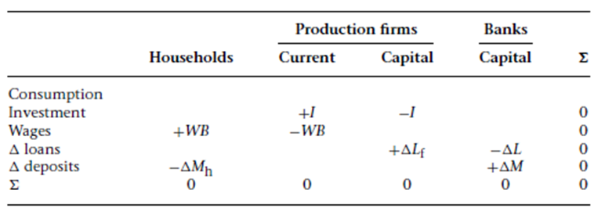
Production with bank money Step 2.
Firms transfer the deposits via check or electronic deposit to workers who produce goods for the firm.
Output has been produced but not sold. Unsold production increases inventories and is treated as investment in working capital that the firm purchases from itself at the cost of production (the wage-bill).
How does the payment of wages (WB) and investment in working capital (I) affect the transaction matrix?

Slide 5
Discussion
Did the stock of money, as Friedman posited, fall from a helicopter with no counterpart in the rest of the economy?
Do changes in the real economy and the resulting financial flows affect the stock of money? Is the stock of money exogenously or endogenously determined?

Slide 6
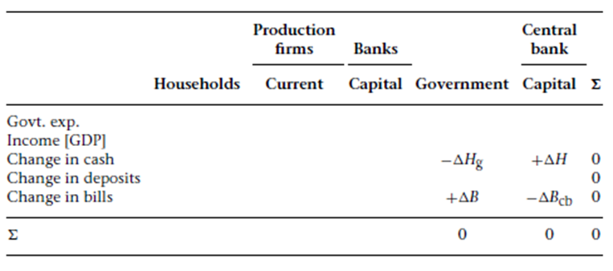
Production with high powered money (HPM) Step 1.
Government orders goods from firms. To purchase the goods, the government sells bonds to the central bank.
How does the sale of bonds (B) to the Central Bank in exchange for HPM (H) show up in the matrix?

Slide 7
Production with high powered money (HPM) Step 2.
Government purchases goods from firms (G). Firms receive checks, drawn on the govt’s account at the Central Bank.
Firms deposits the checks into their account at the bank, creating deposits (M) and increasing the cash (H) held by banks.
Represent these transactions on the matrix.

Slide 8
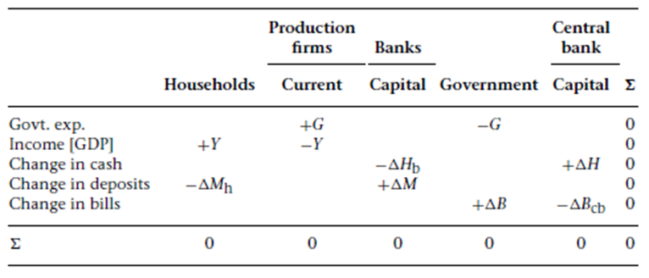
Production with high powered money (HPM) Step 3.
Firms use the deposits to pay workers and distribute all profit to owners: all income (Y) is distributed to households.
Household deposits check into their account at the bank.
Represent these transactions on the matrix.

Slide 9
Discussion
In accordance with mainstream textbooks, government deficit created reserves held by banks.
Does this increase in reserves lead to the creation of a multiple of money deposits as told in the money multiplier story?

Slide 10
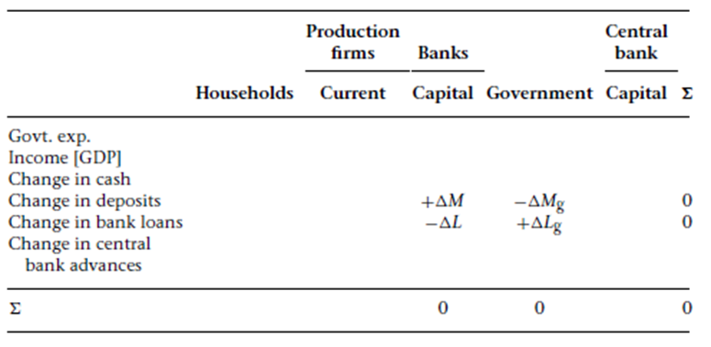
Overdraft economy
Assume that firms don’t hold financial assets but depend on banks for liquidity.
Private banks, rather than hold government securities, borrow from the central bank to obtain the reserves and cash they need. Banks are in debt to the Central Bank.
Government expenditure (G) is financed by a loan (L) from banks to the government which creates deposits (M).

Slide 11
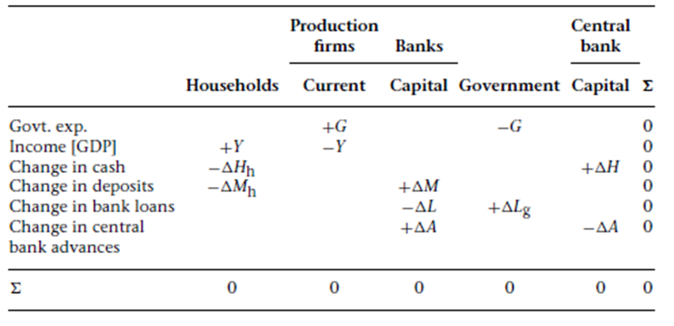
Overdraft economy
The expenditure generates income (Y) which is paid to households which keep part of it as money balances (M) and part of it as cash (H).
To meet their cash needs, banks take advances (A) from the Central Bank.

Slide 12
Discussion
How does the central bank achieve its targeted interest rate in the overdraft system?

